Slide 1
ENGR 12
Dr. Mandala
Notes:
Down

Slide 2
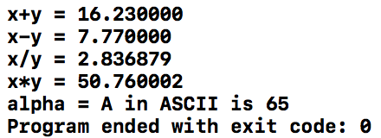
In your teams
Write a C-code that does the following:
Create one integer variable, x and assign a value of 12
Create one float variable, y and assign a value of 4.23
Create one character variable, alpha and assign a value of ‘A’
Calculate the sum, difference, division, and multiplication of x and y.
Print each of these values on screen in the format below:
Hint: %d prints variables as integers, %f as float, %c as character.
Any math operation involving a float number gives a float number

Slide 3
How to display data?
C header file stdio.h contains functions to accept keyboard entry and display data to screen.
printf(“string [conversion characters]”,[argument list]);
Example 1:
printf(“Hello world!\nMorning!”);
OUTPUT: Hello world!
Morning!
Example 2:
int result_score=256;
int avg_score=78;
printf(“The result is = %d\nAverage = %d”,result_score,avg_score);
OUTPUT: The result is 256
Average = 78

Slide 4
conversion Characters
float numvar = 3.145; int numv = 3;
CHARACTER | description | example
d | Display integer | 3
f | Display the floating point number using decimal representation | 3.145000
e | Display the floating point number using scientific notation with e | 3.145000e+00
E | Like e, but with E in the output | 3.145000E+00
g | Use shorter of the two representations: f or e | 3.145
G | Like g, except uses the shorter of f or E | 3.145
c | Display character | A
s | Display string | Hello

Slide 5
Width and precision modifiers
By default, %f, %e, etc. produce 6 digits past the decimal
Example: 3.145000 or 3.145000e+00
You can change formatting output for most modifiers by using width and precision modifiers
%0.2f = 3.14 and %0.2e = 3.14e+00
Syntax for modifiers (IMP: NO empty spaces between the characters!)
% [modifier] [conversion character]
modifier can be width.precision
e.g. 4.2
width represents minimum width
e.g. 4 which will display _ _ _ _ (empty spaces) at a minimum
precision represents maximum precision
e.g. .2 which will display 2 digits (in case of float round to 2 digits)

Slide 6
Modifiers
float numvar = 3.145; int numv = 3; char name[]=“Jonathan”
Modifier | display
%3d | 3
%3.2d | 0 3
%0.2d | 0 3
%3f | 3 . 1 4 5 0 0 0
%3.2f | 3 . 1 4
%0.2f | 3 . 1 4
%10s | J o n a t h a n
%0.4s | J o n a
_ represents a single character width (when blank = space)

Slide 7
Data types
Syntax | Description | Conversion char | Use
short int or short short unsigned int | uses 2 bytes of memory | h | %hd %hu
long int or long long unsigned int | uses 4 bytes of memory | l (lower case L) | %ld %lu
double | uses 8 bytes of memory *has double precision (up to15 decimal digits) of float | l (lower case L) | %lf or %lg
long double | uses at least 8 bytes (and if allowed more) *has precision at least as much as double, and more if allowed. | L | %Lf or %Lg
EXAMPLES: | short score = 3; long unsigned int grades = 132434531; short unsigned score=12;

Slide 8
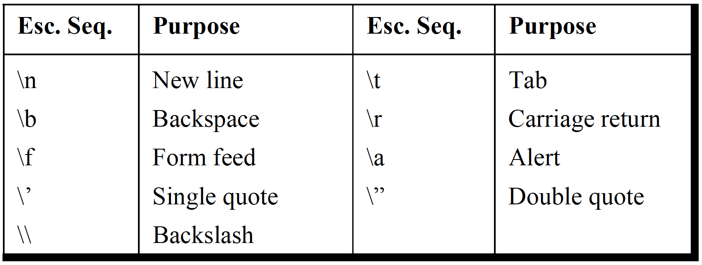
escape sequence
How do you print a % sign?
short scores = 79;
printf (“The score is %d%%”,scores);
OUTPUT: The score is 79%

Slide 9
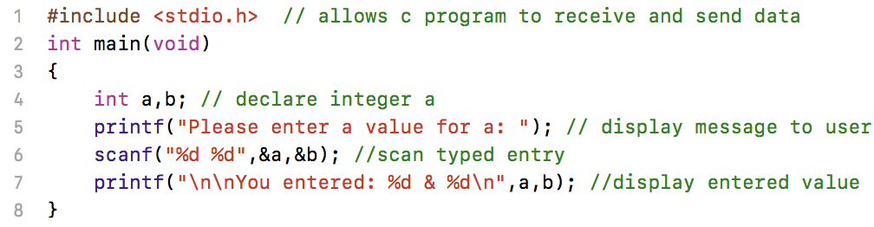
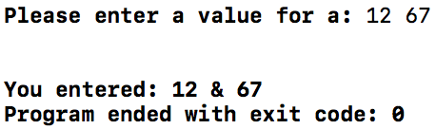
Reading data into C
Use scanf command (prototyped in header file stdio.h)
SYNTAX
scanf(“format string”,&variable_list)
scanf does not print any value to screen!! Use printf to display a message to let user know that they need to type data.

Slide 10
Windows ONLY Error
Windows users might encounter issues with using scanf in Visual Studio; there is nothing wrong with the command, the issue is rather a Microsoft issue
The following steps show you how to fix the problem:
After opening a project, click on PROJECT in the toolbar, then on Properties option at the bottom of the list
Select (left panel) Configuration Properties > C/C++ > Preprocessor
Select (right panel) Preprocessor Definition and click on the arrow that appears
Select Edit and enter: _CRT_SECURE_NO_WARNINGS
Click OK
You can also place the following line at the very top (before preprocessor macros) of your code: #define _CRT_SECURE_NO_WARNINGS

Slide 11
scanf utility
scanf is basic but powerful. It scans for text entry and picks the bits you want (specified by conversion characters)
Use | KEYBOARD STREAM | Values selected
scanf(”%d %f”,&a,&b) | 12 _ ⏎45.313 | a=12 b=45.313
scanf(“mahi%d”,&a) | mahi12 _ 34.3 | a=12
scanf(“%d”,&a); scanf(”%c”,&n); | 12 _ A | a=12 n=’_’
scanf(“%d”,&a); fflush(stdin); scanf(”%c”,&n); | 12 _ A | a=12 n=’A’

Slide 12
Arrays
In C, arrays are just an ordered list of numbers or characters associated with a single variable name
When defining arrays, note that:
C uses brackets [ ] to enclose the array index values
C requires separate brackets to distinguish between the index of values (e.g., A[1][2], instead of MATLAB notation of A(1,2))
C starts its index at zero (e.g., A[0] refers to the first element in A)
In C you must define arrays based on the data type (int, float, double) associated with the values you wish to store in the array
In C you must define the size of the array before using it
In C can define N-dimensional arrays
In C you use braces to define values and must use commas between elements (e.g., A[5]={1,2,3,4,5})

Slide 13
Example
int x[3]={1,2,3};//1x3 array
double y[2];//1x2 array
y[0] = 1.5;
y[1] = 4.0;
/* 2x3 arrays; note that the nested braces, which indicate the intended row in y, are optional */
int y[2][3]={
{1,2,0},
{4,5,6}
};
/* x is equivalent to y */
int x[2][3]={1,2,0,4,5,6};

Slide 14
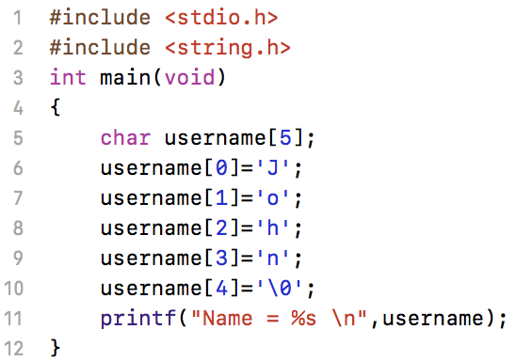
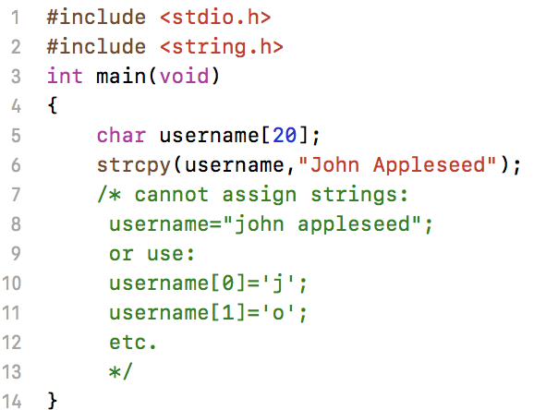


String Arrays
In C, strings are stored as character arrays
end of LIFE character: \0
helps C identify end of string
strcpy automatically adds end of string \0
requires header file: string.h

Slide 15
Handout
Download and work on handout

